Slide 1
Natural Language Processing Workshop
(Insights Team - CDS)
Ziwei Gu
Slides adapted from Claire Cardie, Joseph Devlin and Christopher Manning

Slide 2
Contents
Overview
Basics
Advanced
Current trend
An example – BERT
Demo – Topic Modeling
Demo – LSTMs

Slide 3
Overview of field
algorithm
NL input → → NL output
Themes:
Fundamental problem: handling often massive ambiguity
ML Approach requires lots of data
But Zipf’s law applies in NLP, so data is often sparse
Evaluation is hard
External resources required
Al-complete: To solve NLP, you’d need to solve all of the problem in AI
Turing test

Slide 4
Contents
Overview
Basics
Advanced
Current trend
An example – BERT
Demo – Topic Modeling
Demo – LSTMs

Slide 5
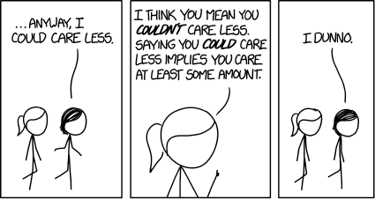
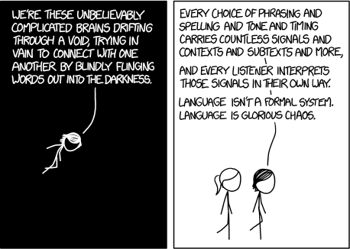
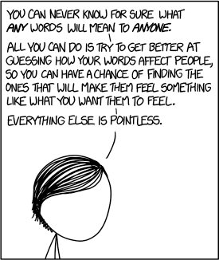
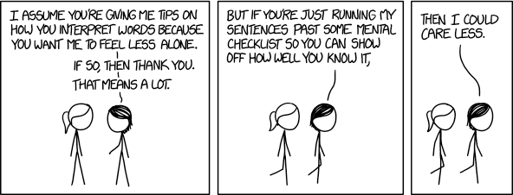
https://xkcd.com/1576/ Randall Munroe CC BY NC 2.5

Slide 6
Word Vectors
How to represent the meaning of a word?
• WordNet?
• One-hot vectors?
motel = [0 0 0 0 0 0 0 0 0 0 1 0 0 0 0]
hotel = [0 0 0 0 0 0 0 1 0 0 0 0 0 0 0]
Problems:
Can’t compute accurate word similarity
Missing new (meanings of) words
e.g., wicked, badass, nifty, wizard, genius, ninja, bombest

Slide 7
Word Vectors
Distributional semantics: A word’s meaning is given by the words that frequently appear close-by
“You shall know a word by the company it keeps” (J. R. Firth 1957: 11)
…government debt problems turning into
…saying that Europe needs unified
…India has just given its
banking
banking banking
crises as happened in 2009…
regulation to replace the hodgepodge… system a shot in the arm…
These context words will represent banking

Slide 8
Word Embeddings
0.286
0.792
−0.177
−0.107
0.109
−0.542
0.349
0.271
banking =
We want to build a dense vector for each word, chosen so that it is similar to vectors of words that appear in similar contexts

Slide 9
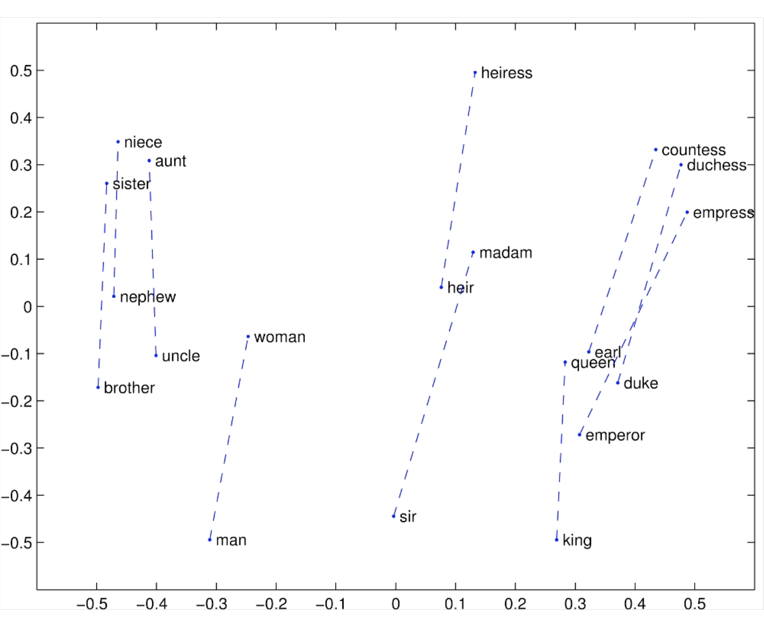
Glove Visualizations

Slide 10
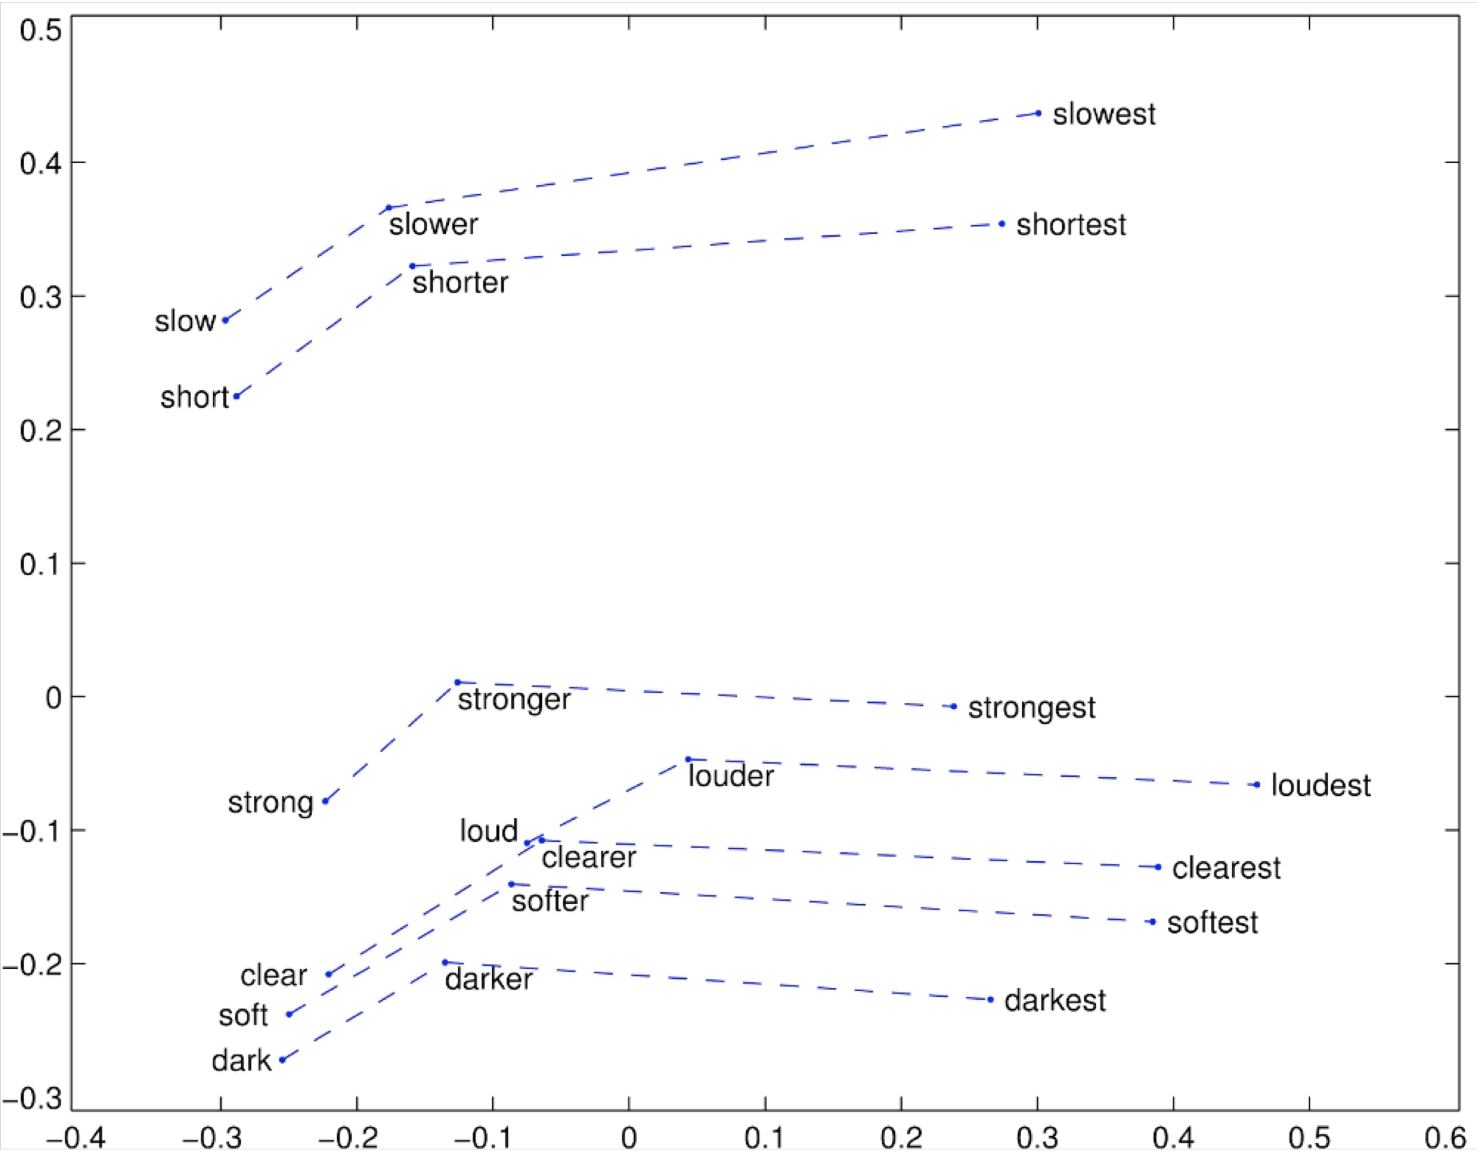
Glove Visualizations: Superlatives

Slide 11
Word2Vec Overview
Word2vec (Mikolov et al. 2013) is a framework for learning word vectors
Idea:
We have a large corpus of text
Every word in a fixed vocabulary is represented by a vector
Go through each position t in the text, which has a center word
c and context (“outside”) words o
Use the similarity of the word vectors for c and o to calculate the probability of o given c (or vice versa)
Keep adjusting the word vectors to maximize this probability

Slide 12
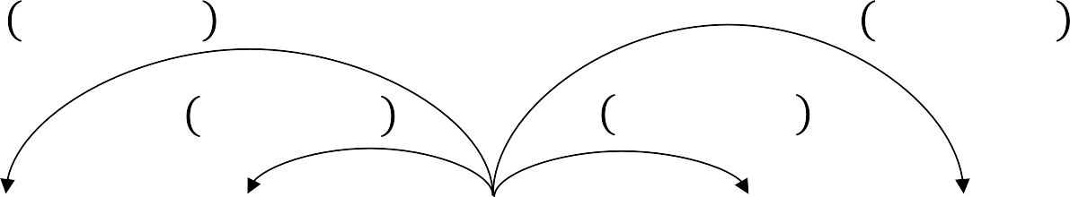
Word2Vec
Example windows and process for computing 5 6₇₈₉ | 6₇
5 6_{7=<} | 6₇
5 6_{7=;} | 6₇
5 6_{78<} | 6₇
5 6_{78;} | 6₇
…
problems
turning
into
banking
crises
as
…
outside context words in window of size 2
center word at position t
outside context words in window of size 2

Slide 13
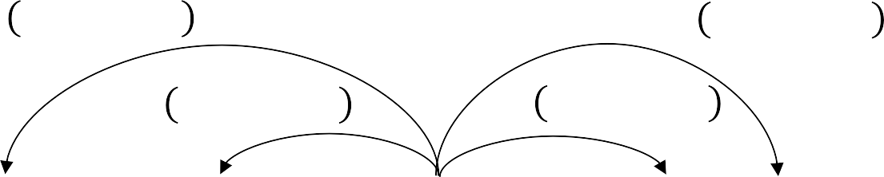
Word2Vec
Example windows and process for computing 5 6₇₈₉ | 6₇
5 6_{7=<} | 6₇
5 6_{7=;} | 6₇
5 6_{78<} | 6₇
5 6_{78;} | 6₇
…
problems
turning
into
banking
crises
as
…
outside context words in window of size 2
center word at position t
outside context words in window of size 2

Slide 14
Word2Vec
Two vectors for each word - why? → Easier optimization. Average both at the end.
Two model variants:
Skip-grams (SG)
Predict context (”outside”) words (position independent) given center word
Continuous Bag of Words (CBOW)
Predict center word from (bag of) context words
Training Method:
1. Negative sampling
2. Hierarchical softmax

Slide 15
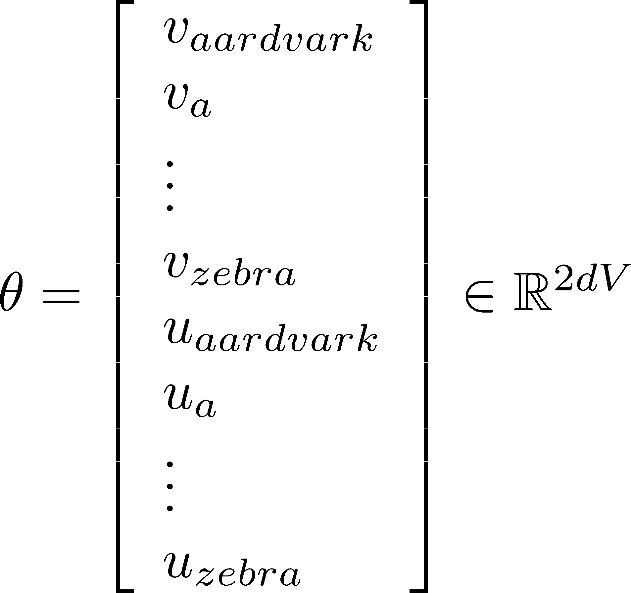
Word2Vec
To train the model: Compute all vector gradients
All model parameters, in one long vector
In our case with d-dimensional vectors and V-many words:
We optimize these parameters by walking down the gradient

Slide 16
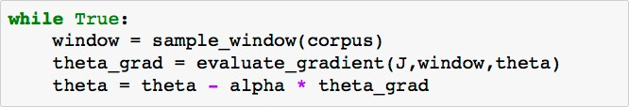
Word2Vec - SGD
Problem: ! " is a function of all windows in the corpus (potentially billions!)
very expensive to compute
You would wait a very long time before making a single update!
Very bad idea for pretty much all neural nets
Solution: Stochastic gradient descent (SGD)
Repeatedly sample windows, and update after each one
Algorithm:

Slide 17
Preprocessing in NLP: NLTK
Tokenization: the task of segmenting running text into words
Normalization: the task of putting words/tokens in a standard format
Collapsing words: Lemmatization and Stemming
Lemmatization: determining that two words have the same root, despite their surface differences.
Stemming: chopping off word-final affixes
byte-pair encoding, or BPE: most tokens are words, but some tokens are frequent word parts like -er, so that an unseen word can be represented by combining the parts.

Slide 18
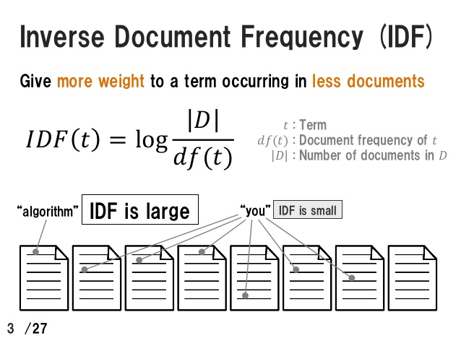
TF-IDF weighting
Intuition: Not all words are equally important in a set of documents
tf: # times a word appears in a document
idf: # documents that contain this word

Slide 19
Contents
Overview
Basics
Advanced
Current trend
An example – BERT
Demo – Topic Modeling
Demo – LSTMs

Slide 20
Language Models
Language Modeling
motivates
Introduce a new family of neural networks
Recurrent Neural Networks (RNNs)

Slide 21
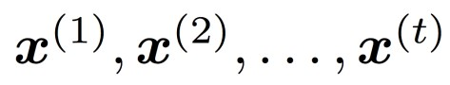
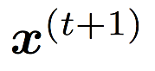
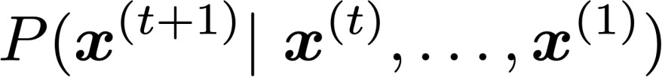
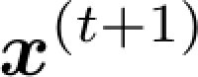
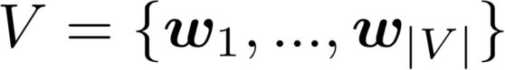
Language Models
Language Modeling is the task of predicting what word comes
next.
books
laptops
the students opened their
exams
minds
More formally: given a sequence of words
compute the probability distribution of the next word
,
:
where can be any word in the vocabulary
A system that does this is called a Language Model.

Slide 22
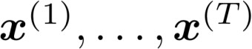
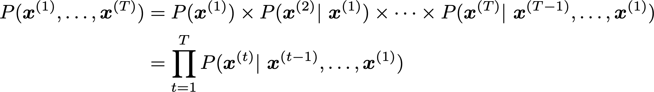
Language Models
A system that assigns probability to a piece of text.
For example, if we have some text , then the probability of this text (according to the Language Model) is:
This is what our LM provides

Slide 23
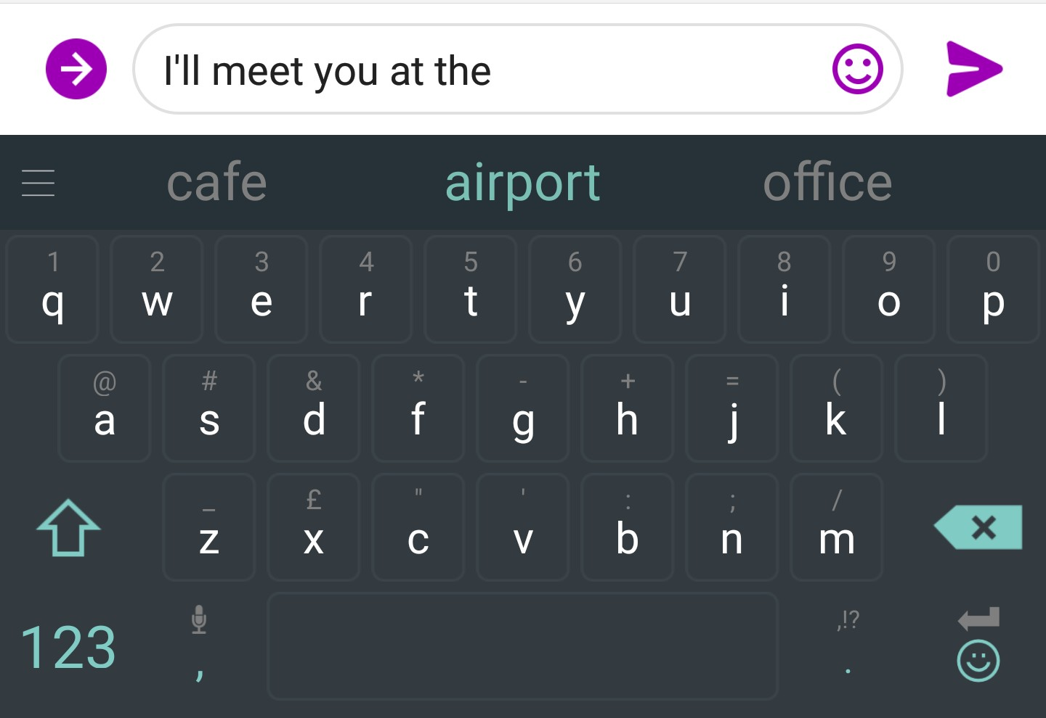
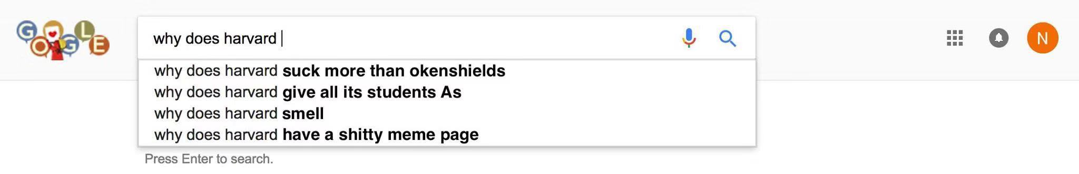
You use Language Models every day!

Slide 24
N-grams
the students opened their
Question: How to learn a Language Model?
Answer (pre- Deep Learning): learn a n-gram Language Model!
Definition: A n-gram is a chunk of n consecutive words.
unigrams: “the”, “students”, “opened”, ”their”
bigrams: “the students”, “students opened”, “opened their”
trigrams: “the students opened”, “students opened their”
4-grams: “the students opened their”
Idea: Collect statistics about how frequent different n-grams are, and use these to predict next word.

Slide 25
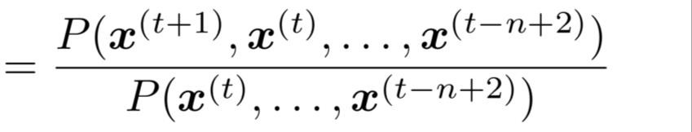
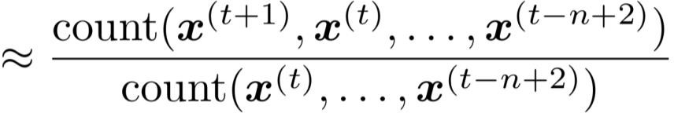
N-grams
First we make a simplifying assumption:
preceding n-1 words.
n-1 words
depends only on the
(assumption)
prob of a n-gram
(definition of conditional prob)
prob of a (n-1)-gram
Question: How do we get these n-gram and (n-1)-gram probabilities?
Answer: By counting them in some large corpus of text!
(statistical approximation)

Slide 26
N-grams
You can build a simple trigram Language Model over a
1.7 million word corpus (Reuters) in a few seconds on your laptop*
Business and financial news
today the
get probability distribution
company |  | 0.153
bank |  | 0.153
price |  | 0.077
italian |  | 0.039
emirate | … | 0.039
Sparsity problem: not much granularity in the probability distribution
Otherwise, seems reasonable!

Slide 27
Language Model
You can also use a Language Model to generate text.
today the
condition on this
get probability distribution
company bank price italian emirate
0.153
0.153
0.077 sample
0.039
0.039
…

Slide 28
Language Model
You can also use a Language Model to generate text.
today the price
condition on this
get probability distribution
of for it to is
0.308 sample
0.050
0.046
0.046
0.031
…

Slide 29
Language Model
You can also use a Language Model to generate text.
today the price of
condition on this
get probability distribution
the 18
oil its gold
0.072
0.043
0.043
0.036
0.018
sample
…

Slide 30
Language Model
You can also use a Language Model to generate text.
today the price of gold

Slide 31
Language Model
You can also use a Language Model to generate text.
today the price of gold per ton , while production of shoe lasts and shoe industry , the bank intervened just after it considered and rejected an imf demand to rebuild depleted european stocks , sept 30 end primary 76 cts a share .
Surprisingly grammatical!
…but incoherent. We need to consider more than three words at a time if we want to model language well.
But increasing n worsens sparsity problem,
and increases model size…

Slide 32
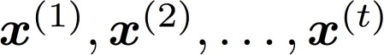

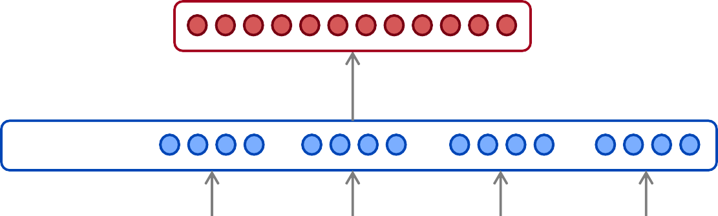


RNN
The Language Modeling task:
Input: sequence of words
Output: prob dist of the next word
How about a window-based neural model?
We saw this applied to Named Entity Recognition in Lecture 3:
LOCATION
museums
in
Paris
are
amazing

Slide 33
RNN
as the proctor started the clock
the
students opened
fixed window
their
discard

Slide 34


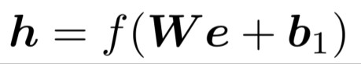



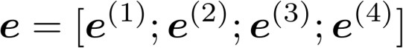



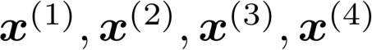
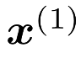
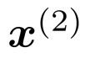
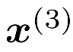
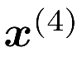
RNN
books
laptops
output distribution
a
zoo
hidden layer
concatenated word embeddings
words / one-hot vectors
the
students
opened
their

Slide 35
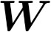
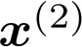
RNN
Improvements over n-gram LM:
books
No sparsity problem
Don’t need to store all observed
n-grams
laptops
Remaining problems:
a
zoo
Fixed window is too small
Enlarging window enlarges
Window can never be large enough!
and are multiplied by completely different weights in
•
.
No symmetry in how the inputs are processed.
We need a neural architecture that can process any length input
the
students
opened
their

Slide 36
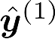
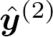
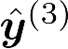
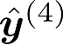
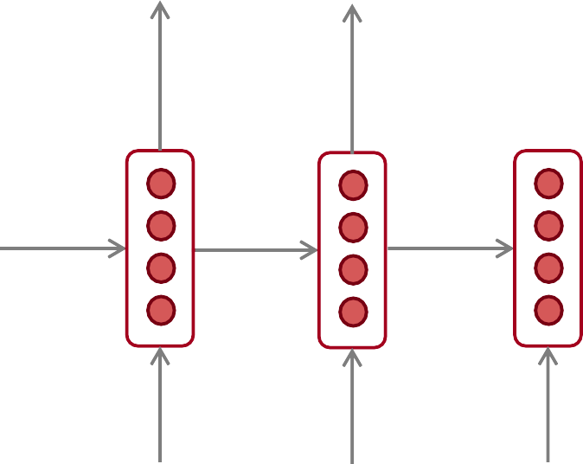
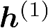
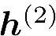
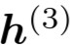
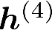



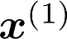
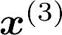
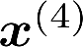
RNN
Core idea: Apply the same weights repeatedly
outputs (optional)
…
hidden states
…
input sequence (any length)
…

Slide 37
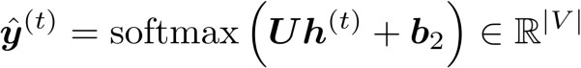


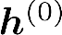

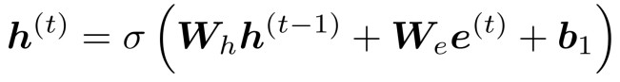
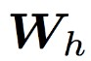
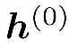











RNN
books
laptops
output distribution
a
zoo
hidden states
is the initial hidden state
word embeddings
words / one-hot vectors the students
opened
their
Note: this input sequence could be much
longer, but this slide doesn’t have space!

Slide 38
RNN
books
laptops
RNN Advantages:
Can process any length
input
Computation for step t can (in theory) use information from many steps back
Model size doesn’t
increase for longer input
Same weights applied on every timestep, so there is symmetry in how inputs are processed.
a
zoo
RNN Disadvantages:
Recurrent computation is slow
In practice, difficult to access information from many steps back
More on these later in the course
the
students
opened
their

Slide 39





RNN
Get a big corpus of text which is a sequence of words
Feed into RNN-LM; compute output distribution for every step t.
i.e. predict probability dist of every word, given words so far
Loss function on step t is cross-entropy between predicted probability
distribution , and the true next word (one-hot for ):
Average this to get overall loss for entire training set:

Slide 40




Training an RNN Language Model
= negative log prob
of “students”
Loss
Predicted prob dists
…
Corpus
40
the
students
opened
their
exams
…

Slide 41
Training an RNN Language Model
= negative log prob
of “opened”
Loss
Predicted prob dists
…
Corpus
the
students
opened
their
exams
…

Slide 42
Training an RNN Language Model
= negative log prob
of “their”
Loss
Predicted prob dists
…
Corpus
the
students
opened
their
exams
…

Slide 43
Training an RNN Language Model
= negative log prob
of “exams”
Loss
Predicted prob dists
…
Corpus
the
students
opened
their
exams
…

Slide 44

Training an RNN LM
Loss
+
+
+
+ … =
Predicted prob dists
…
Corpus
the
students
opened
their
exams
…

Slide 45





Training an RNN LM
Just like a n-gram Language Model, you can use a RNN Language Model to
generate text by repeated sampling. Sampled output is next step’s input.
favorite season is
sample sample sample
spring
sample
…
my
favorite
season
is
spring

Slide 46


RNN Language Models
You can train a RNN-LM on any kind of text, then generate text in that style.
RNN-LM trained on Harry Potter:
Source: https://medium.com/deep-writing/harry-potter-written-by-artificial-intelligence-8a9431803da6

Slide 47



Evaluating LMs
The standard evaluation metric for Language Models is perplexity.
Normalized by number of words
Inverse probability of corpus, according to Language Model
This is equal to the exponential of the cross-entropy loss
:
Lower perplexity is better!

Slide 48
Language Models
Language Modeling is a benchmark task that helps us measure our progress on understanding language
Language Modeling is a subcomponent of many NLP tasks, especially those involving generating text or
estimating the probability of text:
Predictive typing
Speech recognition
Handwriting recognition
Spelling/grammar correction
Authorship identification
Machine translation
Summarization
Dialogue
etc.

Slide 49

RNN Language Models
e.g. part-of-speech tagging, named entity recognition
DT
JJ
NN
VBN
IN
DT
NN
the
startled
cat
knocked
over
the
vase

Slide 50





RNN Language Models
e.g. sentiment classification
positive
How to compute sentence encoding?
Basic way:
Use final hidden state
Sentence encoding
overall
I
enjoyed
the
movie
a
lot

Slide 51



RNN Language Models
e.g. question answering, machine translation, many other tasks!
Answer: German
Here the RNN acts as an encoder for the Question (the hidden states represent the Question). The encoder is part of a larger neural system.
Context: Ludwig van Beethoven was a German composer and pianist. A crucial figure …
Question:
what
nationality
was Beethoven
?

Slide 52

RNN Language Models
e.g. speech recognition, machine translation, summarization
RNN-LM
what’s
the
weather
Input (audio)
conditioning
<START>
what’s
the
This is an example of a conditional language model.

Slide 53












RNN
Vanishing gradient intuition
chain rule!

Slide 54


RNN
Vanishing gradient intuition
chain rule!

Slide 55


RNN
Vanishing gradient intuition
chain rule!

Slide 56
RNN
Vanishing gradient intuition
Vanishing gradient problem: When these are small, the gradient signal gets smaller and smaller as it backpropagates further
What happens if these are small?

Slide 57

RNN
Why is vanishing gradient a problem?
Gradient signal from faraway is lost because it’s much
smaller than gradient signal from close-by.
So model weights are only updated only with respect to near effects, not long-term effects.

Slide 58

Gradient Clipping
Gradient clipping: if the norm of the gradient is greater than some threshold, scale it down before applying SGD update
Intuition: take a step in the same direction, but a smaller step
Source: “On the difficulty of training recurrent neural networks”, Pascanu et al, 2013. http://proceedings.mlr.press/v28/pascanu13.pdf

Slide 59

Gradient Clipping
This shows the loss surface of a simple RNN (hidden state is a scalar not a vector)
The “cliff” is dangerous because it has steep gradient
On the left, gradient descent takes two very big steps due to steep gradient, resulting in climbing the cliff then shooting off to the right (both bad updates)
On the right, gradient clipping reduces the size of those steps, so effect is less drastic
Source: “Deep Learning”, Goodfellow, Bengio and Courville, 2016. Chapter 10.11.1. https://www.deeplearningbook.org/contents/rnn.html

Slide 60


LSTMs
A type of RNN proposed by Hochreiter and Schmidhuber in 1997 as a
solution to the vanishing gradients problem.
On step t, there is a hidden state and a cell state
Both are vectors length n
The cell stores long-term information
The LSTM can erase, write and read information from the cell
The selection of which information is erased/written/read is controlled by three corresponding gates
The gates are also vectors length n
On each timestep, each element of the gates can be open (1), closed (0), or somewhere in-between.
The gates are dynamic: their value is computed based on the current context
“Long short-term memory”, Hochreiter and Schmidhuber, 1997. https://www.bioinf.jku.at/publications/older/2604.pdf

Slide 61




LSTMs
We have a sequence of inputs , and we will compute a sequence of hidden states and cell states . On timestep t:
Sigmoid function: all gate values are between 0 and 1
Forget gate: controls what is kept vs forgotten, from previous cell state
Input gate: controls what parts of the new cell content are written to cell
All these are vectors of same length n
Output gate: controls what parts of cell are output to hidden state
New cell content: this is the new content to be written to the cell
Cell state: erase (“forget”) some content from last cell state, and write (“input”) some new cell content
Hidden state: read (“output”) some content from the cell
Gates are applied using element-wise product

Slide 62


LSTMs
Long Short-Term Memory (LSTM)
You can think of the LSTM equations visually like this:
Source: http://colah.github.io/posts/2015-08-Understanding-LSTMs/

Slide 63

LSTMs
You can think of the LSTM equations visually like this:
Write some new cell content
Forget some
cell content
c_{t}
c_{t}
^{c}t-1
f
i_{t}
o_{t}
Output some cell content to the hidden state
Compute the forget gate
t
~_{c}
t
^{h}t-1
h_{t}
Compute the input gate
Compute the new cell content
Compute the output gate
Source: http://colah.github.io/posts/2015-08-Understanding-LSTMs/

Slide 64
LSTMs
The LSTM architecture makes it easier for the RNN to preserve information over many timesteps
e.g. if the forget gate is set to remember everything on every timestep, then the info in the cell is preserved indefinitely
By contrast, it’s harder for vanilla RNN to learn a recurrent
weight matrix W_{h} that preserves info in hidden state
LSTM doesn’t guarantee that there is no vanishing/exploding gradient, but it does provide an easier way for the model to learn long-distance dependencies

Slide 65


LSTMs
Proposed by Cho et al. in 2014 as a simpler alternative to the LSTM.
On each timestep t we have input and hidden state (no cell state).
Update gate: controls what parts of hidden state are updated vs preserved
Reset gate: controls what parts of previous hidden state are used to compute new content
New hidden state content: reset gate selects useful parts of prev hidden state. Use this and current input to compute new hidden content.
Hidden state: update gate simultaneously controls what is kept from previous hidden state, and what is updated to new hidden state content
How does this solve vanishing gradient? Like LSTM, GRU makes it easier to retain info long-term (e.g. by setting update gate to 0)
"Learning Phrase Representations using RNN Encoder–Decoder for Statistical Machine Translation", Cho et al. 2014, https://arxiv.org/pdf/1406.1078v3.pdf

Slide 66
LSTMs
Researchers have proposed many gated RNN variants, but LSTM and GRU are the most widely-used
The biggest difference is that GRU is quicker to compute and has fewer parameters
There is no conclusive evidence that one consistently performs better than the other
LSTM is a good default choice (especially if your data has particularly long dependencies, or you have lots of training data)
Rule of thumb: start with LSTM, but switch to GRU if you want something more efficient

Slide 67



LSTMs
Bidirectional RNNs: motivation
Task: Sentiment Classification
We can regard this hidden state as a
representation of the word “terribly” in the context of this sentence. We call this a contextual representation.
positive
Sentence encoding
These contextual representations only contain information about the left context (e.g. “the movie
was”).
What about right
context?
In this example, “exciting” is in the right context and this modifies the meaning of “terribly” (from negative to positive)
the
movie
was
terribly
exciting
!

Slide 68

LSTMs
Bidirectional RNNs
This contextual representation of “terribly”
has both left and right context!
Concatenated hidden states
Backward RNN
Forward RNN
the
movie
was
terribly
exciting
!

Slide 69

LSTMs
On timestep t:
This is a general notation to mean “compute one forward step of the RNN” – it could be a vanilla, LSTM or GRU computation.
Forward RNN
Generally, these two RNNs have separate weights
Backward RNN
Concatenated hidden states
We regard this as “the hidden state” of a bidirectional RNN. This is what we pass on to the next parts of the network.

Slide 70

LSTMs
Bidirectional RNNs: simplified diagram
the
movie
was
terribly
exciting
!
The two-way arrows indicate bidirectionality and the depicted hidden states are assumed to be the concatenated forwards+backwards states.

Slide 71
Bidirectional RNNs
Note: bidirectional RNNs are only applicable if you have access to the entire input sequence.
They are not applicable to Language Modeling, because in LM you only have left context available.
If you do have entire input sequence (e.g. any kind of encoding), bidirectionality is powerful (you should use it by default).
For example, BERT (Bidirectional Encoder Representations from Transformers) is a powerful pretrained contextual representation system built on bidirectionality.
You will learn more about BERT later in the course!

Slide 72
Multilayer RNNs
RNNs are already “deep” on one dimension (they unroll over
many timesteps)
We can also make them “deep” in another dimension by
applying multiple RNNs – this is a multi-layer RNN.
This allows the network to compute more complex representations
The lower RNNs should compute lower-level features and the
higher RNNs should compute higher-level features.
Multi-layer RNNs are also called stacked RNNs.

Slide 73

Multilayer RNNs
The hidden states from RNN layer i
are the inputs to RNN layer i+1
RNN layer 3
RNN layer 2
RNN layer 1
the
movie
was
terribly
exciting
!

Slide 74
Multilayer RNNs
High-performing RNNs are often multi-layer (but aren’t as deep
as convolutional or feed-forward networks)
For example: In a 2017 paper, Britz et al find that for Neural Machine Translation, 2 to 4 layers is best for the encoder RNN, and 4 layers is best for the decoder RNN
However, skip-connections/dense-connections are needed to train deeper RNNs (e.g. 8 layers)
Transformer-based networks (e.g. BERT) can be up to 24 layers
You will learn about Transformers later; they have a lot of skipping-like connections

Slide 75



RNN Summary
1. LSTMs are powerful but GRUs are faster
2. Clip your gradients
3. Use bidirectionality when possible
4. Multi-layer RNNs are powerful, but you might need skip/dense-connections if it’s deep

Slide 76
Contents
Overview
Basics
Advanced
Current trend
An example – BERT
Demo – Topic Modeling
Demo – LSTMs

Slide 77
Current trends
making clever use of “free” data.
Pretraining: ”The ImageNet moment has arrived”
“Attention is all you need”
Attention is All You Need. Vaswani et al. NIPS 2017.
Get To The Point: Summarization with Pointer-Generator Networks. Abigail See, Peter J. Liu, Christopher D. Manning. ACL 2017.
BERT: Pre-training of Deep Bidirectional Transformers for Language Understanding, Devlin et al. arXiv Oct 2018.

Slide 78
Further readings
- General intro to NLP: Speech and Language Processing, Jurafsky and Martin (3rd edition), in preparation. [link]
- Advanced intro to NLP focused on ML methods (notes): Jacob Eisenstein. [link]
- Neural Network Methods in Natural Language Processing, Y. Goldberg, 2017. [link]
- word2vec Explained: deriving Mikolov et al.'s negative-sampling word-embedding method. Yoav Goldberg, Omer Levy. [link]
- Recurrent Neural Networks Tutorial, Part 1 – Introduction to RNNs. Denny Britz. 2015. [link]
- Recurrent Neural Networks Tutorial, Part 3 – Backpropagation Through Time and Gradients. Denny Britz. 2015. [link]
- The Unreasonable Effectiveness of Recurrent Neural Networks. Andrej Karpathy blog. [link]

Slide 79
Contents
Overview
Basics
Advanced
Current trend
An example – BERT
Demo – Topic Modeling
Demo – LSTMs

Slide 80
BERT: Pre-training of Deep Bidirectional Transformers for Language Understanding
(Bidirectional Encoder Representations from Transformers)

Slide 81
Pre-training in NLP
Word embeddings are the basis of deep learning for NLP
king
queen
[-0.5, -0.9, 1.4, …]
[-0.6, -0.8, -0.2, …]
Word embeddings (word2vec, GloVe) are often pre-trained on text corpus from co-occurrence statistics
Inner Product
Inner Product
the king wore a crown
the queen wore a crown

Slide 82
Contextual Representations
Problem: Word embeddings are applied in a context free manner
open a bank account on the river bank
[0.3, 0.2, -0.8, …]
Solution: Train contextual representations on text corpus
[0.9, -0.2, 1.6, …]
[-1.9, -0.4, 0.1, …]
open a bank account
on the river bank

Slide 83

History of Contextual Representations
Semi-Supervised Sequence Learning, Google, 2015
Train LSTM Language Model
Fine-tune on Classification Task
open
a
bank
POSITIVE
LSTM
LSTM
LSTM
...
LSTM
LSTM
LSTM
<s>
open
a
very
funny
movie

Slide 84
History of Contextual Representations
ELMo: Deep Contextual Word Embeddings, AI2 & University of Washington, 2017
Train Separate Left-to-Right and Right-to-Left LMs
Apply as “Pre-trained Embeddings”
open
a
bank
<s>
open
a
Existing Model Architecture
LSTM
LSTM
LSTM
LSTM
LSTM
LSTM
<s>
open
a
open
a
bank
open
a
bank

Slide 85

History of Contextual Representations
Improving Language Understanding by Generative Pre-Training, OpenAI, 2018
Train Deep (12-layer) Transformer LM
Fine-tune on Classification Task
POSITIVE
open
a
bank
Transformer
Transformer
Transformer
Transformer
Transformer
Transformer
<s>
open
a
<s>
open
a

Slide 86
Problem with Previous Methods
Problem: Language models only use left context or right context, but language understanding is bidirectional.
Why are LMs unidirectional?
Reason 1: Directionality is needed to generate a well-formed probability distribution.
We don’t care about this.
Reason 2: Words can “see themselves” in a bidirectional encoder.

Slide 87
Unidirectional vs. Bidirectional Models
Unidirectional context
Build representation incrementally
Bidirectional context
Words can “see themselves”
open
a
bank
open
a
bank
Layer 2
Layer 2
Layer 2
Layer 2
Layer 2
Layer 2
Layer 2
Layer 2
Layer 2
Layer 2
Layer 2
Layer 2
<s>
open
a
<s>
open
a

Slide 88
Masked LM
Solution: Mask out k% of the input words, and then predict the masked words
We always use k = 15%
store gallon
the man went to the [MASK] to buy a [MASK] of milk
Too little masking: Too expensive to train
Too much masking: Not enough context

Slide 89
Masked LM
Problem: Mask token never seen at fine-tuning
Solution: 15% of the words to predict, but don’t replace with [MASK] 100% of the time. Instead:
80% of the time, replace with [MASK]
went to the store → went to the [MASK]
10% of the time, replace random word
went to the store → went to the running
10% of the time, keep same
went to the store → went to the store

Slide 90

Next Sentence Prediction
To learn relationships between sentences, predict whether Sentence B is actual sentence that proceeds Sentence A, or a random sentence

Slide 91

Input Representation
Use 30,000 WordPiece vocabulary on input.
Each token is sum of three embeddings
Single sequence is much more efficient.

Slide 92


Model Architecture
Transformer encoder
Multi-headed self attention
Models context
Feed-forward layers
Computes non-linear hierarchical features
Layer norm and residuals
Makes training deep networks healthy
Positional embeddings
Allows model to learn relative positioning

Slide 93
Model Architecture
Empirical advantages of Transformer vs. LSTM:
Self-attention == no locality bias
Long-distance context has “equal opportunity”
Single multiplication per layer == efficiency on TPU
Effective batch size is number of words, not sequences
Transformer
LSTM
X_0_0 | X_0_1 | X_0_2 | X_0_3
X_1_0 | X_1_1 | X_1_2 | X_1_3
X_0_0 |  | X_0_1 | X_0_2 | X_0_3
X_1_0 |  | X_1_1 | X_1_2 | X_1_3
✕
W
✕
W

Slide 94
Model Details
Data: Wikipedia (2.5B words) + BookCorpus (800M words)
Batch Size: 131,072 words (1024 sequences * 128 length or 256 sequences * 512 length)
Training Time: 1M steps (~40 epochs)
Optimizer: AdamW, 1e-4 learning rate, linear decay
BERT-Base: 12-layer, 768-hidden, 12-head
BERT-Large: 24-layer, 1024-hidden, 16-head
Trained on 4x4 or 8x8 TPU slice for 4 days

Slide 95

Fine-Tuning Procedure

Slide 96

GLUE Results
MultiNLI
Premise: Hills and mountains are especially sanctified in Jainism.
Hypothesis: Jainism hates nature. Label: Contradiction
CoLa
Sentence: The wagon rumbled down the road. Label: Acceptable
Sentence: The car honked down the road. Label: Unacceptable

Slide 97




SQuAD 1.1
Only new parameters: Start vector and end vector.
Soft itions.
max over all pos

Slide 98


SQuAD 2.0
Use token 0 ([CLS]) to emit logit for “no answer”.
“No answer” directly competes with answer span.
Threshold is optimized on dev set.

Slide 99



SWAG
Run each Premise + Ending through BERT.
Produce logit for each pair on token 0 ([CLS])

Slide 100
Common Questions
Why did no one think of this before?
Better question: Why wasn’t contextual pre-training popular before 2018 with ELMo?
Good results on pre-training is >1,000x to 100,000 more expensive than supervised training.
E.g., 10x-100x bigger model trained for 100x-1,000x as many steps.
Imagine it’s 2013: Well-tuned 2-layer, 512-dim LSTM sentiment analysis gets 80% accuracy, training for 8 hours.
Pre-train LM on same architecture for a week, get 80.5%.
Conference reviewers: “Who would do something so expensive for such a small gain?”

